Slide 1
Product Management
Prof. Dr. Dirk Riehle
Friedrich-Alexander University Erlangen-Nürnberg
AMOS D01
Licensed under CC BY 4.0 International
Notes:
It is Friedrich-Alexander University Erlangen-Nürnberg – FAU, in short.
Corporate identity wants us to say “Friedrich-Alexander University”.

Slide 2
Product Management (Recap)
Product management
  Is the management of a company’s products
  Along the product’s life-cycle
  Across the product portfolio (if any)

Slide 3
Product Management (Simplified) (Recap)
What?
What first?

Slide 4
Traditional to Scrum Role Mapping (Recap)
Traditional
Scrum
Product Manager
Product Owner
Engineering Manager
Software Developer
Software Developer
Scrum Master
QA Engineer

Slide 5
Product Owner
Product owner
  Holds overall responsibility for the product being developed
  Provides
    product vision,
    product requirements, and
  Plans and helps plan development and
  Tracks progress.

Slide 6
Product Owner Processes and Artifacts
Processes | Artifacts
Opportunity Assessment | Product Vision
Product Specification | Product Glossary, Product Backlog, Feature Archive
Product Planning | Sprint Backlog Release Plan
Progress Tracking | Development Speed Burndown Charts

Slide 7
Product Owner Focus
Scope
Cost
Time
Quality

Slide 8
Opportunity Assessment (Practices)
Research Market
  Responsible: Product owner
  Artifact: Marketing requirements document (MRD)
  Collaborators: Market / customer, funder / sponsor
  Note: not part of Scrum proper
Articulate Vision
  Responsible: Product owner
  Artifact: Product vision
  Collaborators: None

Slide 9
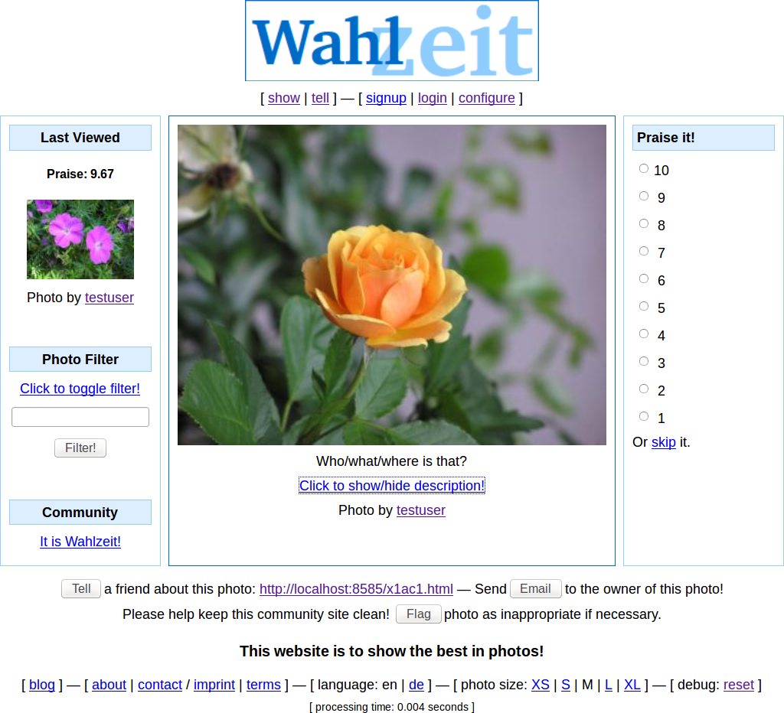

Slide 10
Example Product Vision (Artifact)
Flowers Product Vision
The Flowers social network helps flower enthusiasts worldwide to connect with each other and enjoy following their favorite hobby online. Centered on showing and rating favorite flower photos, it inspires growing and presenting ever more beautiful flowers. With a highly engaged user community, Flowers is the best place for producers and sellers of gardening supply to reach out to customers and engage with them. Such engagement involves understanding flower enthusiasts’ needs around gardening supplies and selling to them.

Slide 11
Product Vision (Artifact)
Product vision
  Captures the essence of the product and the reasons for its existence as the business value it provides to users
  Names users and customers; it embodies the core structure of an underlying business model
Other properties
  Inspiring: Inspires users / customers
  Timeless: Is not bound to a schedule
  Focused: Reduces to the essentials
  Decision aid: Is the ultimate arbiter
Please note that in AMOS we use
  A long-term product vision
  A short-term (AMOS) project mission

Slide 12
Product Specification 1 / 3 (Practices)
Create Glossary
  Responsible: Product owner
  Artifact: Glossary
  Collaborators: Market / customer, developer
Maintain Glossary
  Responsible: Product owner
  Artifact: Glossary
  Collaborators: Market / customer, developer

Slide 13
Example Glossary (Artifact)
Term | Definition
Individual Photo Rating | A photo rating by a single user of a particular photo at a given point in time.
Overall Photo Rating | A photo rating that represents the community's ranking of the photo in question. Over time, a photo accumulates a large number of individual ratings. The overall rating is the average of those individual ratings.
Photo | A photo is a flower photo that has been uploaded (and is owned) by a system user. A photo has a status that determines its accessibility.
Photo Rating | A numerical value 1..10 that rates a given photo.
Photo Sharing Policy | Flowers has a photo sharing policy. The policy determines what an acceptable photo is. Photos are unacceptable if they are unrelated to the Flower's purpose (i.e. off-topic), ...

Slide 14
Glossary (Artifact)
Domain glossary
  A list of concepts and their definition from the product being developed
  The missing link between the vision and the product backlog
  Is a “poor man’s approach” to a domain model
Glossary entries
  Definitions are short; rarely longer than a paragraph
  Glossary entries are human readable
  Usually not machine-processable

Slide 15
Connecting Vision with Product Backlog
Product
Vision
Product
Glossary
Product
Backlog

Slide 16
Quality Criteria for Glossaries
Main entries
  Have a clear fully-defined name for glossary entry
  Have a crisp “is a” definition, followed by secondary properties
  Vary based on type (main concept, enumerations, stati, etc.)
Synonyms
  Synonyms are listed as their own entries
Shorthands
  Shorthands point to the full name (not the other way around)

Slide 17
Quiz: What is Wrong With These Entries?
Term | Definition
KPI | KPI stands for Key Performance Indicator, which is a type of performance measurement. An organization may use KPIs to evaluate the success of a particular activity in which it is engaged.
Visualization | Here visualization means data or information visualization. Charts, graphs, images and other visualization methods are used for presenting the data. In this application we focus on visualization ...
JSON | JSON (JavaScript Object Notation) is a lightweight data-interchange format. It is easy for humans to read and write. It is easy for machines to parse and generate ...

Slide 18
Product Specification 2 / 3 (Practices)
Specify Feature
  Responsible: Product owner
  Artifact: Feature
  Collaborators: Market / customer
Prioritize Features
  Responsible: Product owner
  Artifact: Product backlog
  Collaborators: Market / customer
Manage Features
  Responsible: Product owner
  Artifact: Product backlog, feature archive
  Collaborators: Software developer

Slide 19
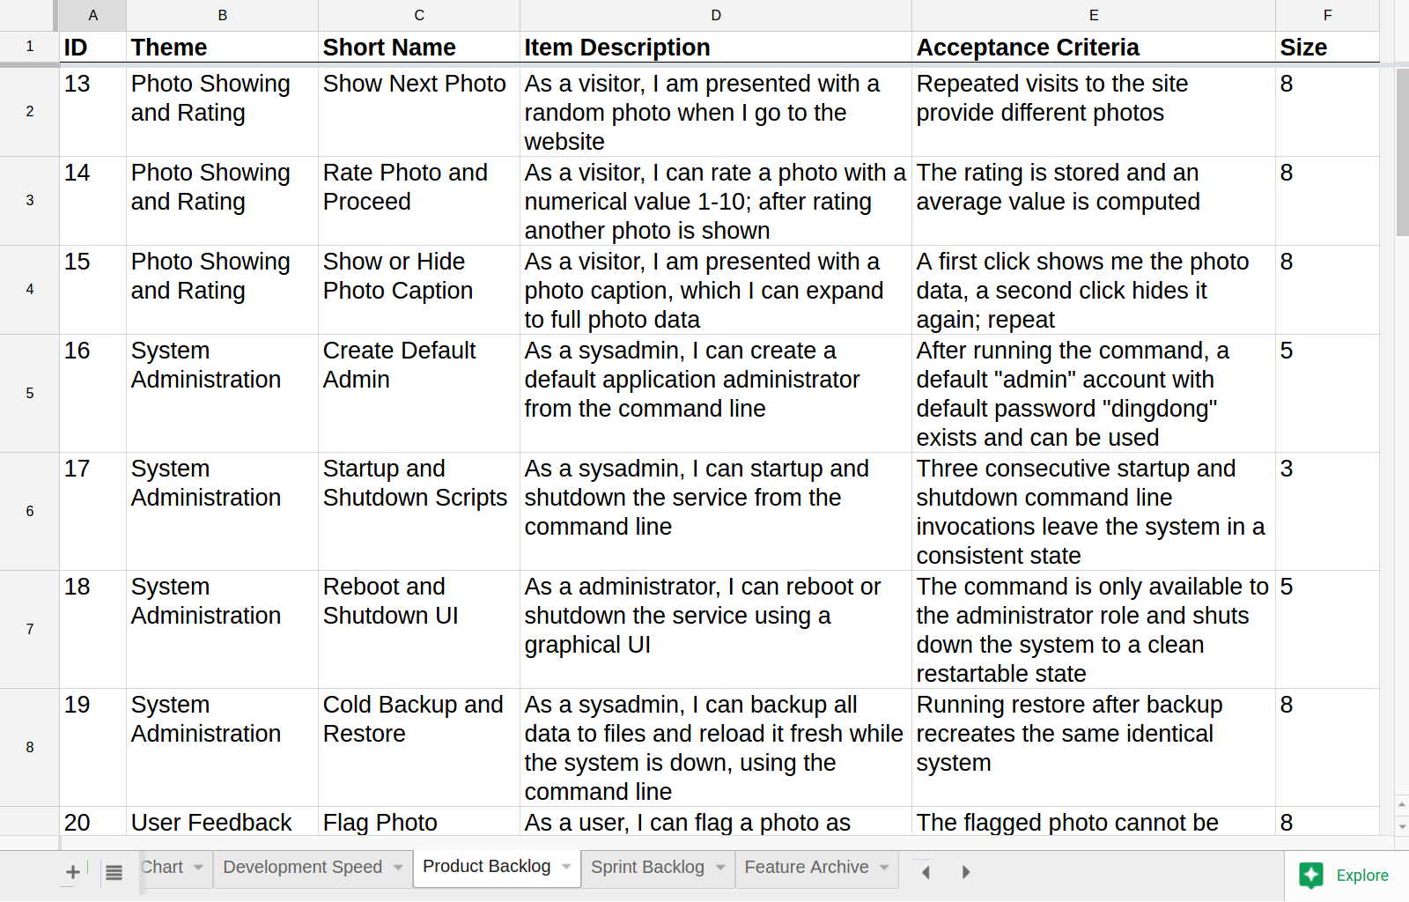
Example Product Backlog (Artifact)

Slide 20
Product Backlog (Artifact)
Product backlog
  Is a prioritized list of product backlog items
  Scrum’s PRD and the product owner's primary work artifact
  Does not contain any task descriptions or assignments
  Is a living document (rather than static) and keeps evolving
Other properties
  Focused: On creating value
  Complete: For current iteration
  Prioritized: According to current needs
  Evolving: Used in future iterations

Slide 21
Product Backlog Item (Artifact)
Product Backlog Item
  Is an entry in the product backlog
  Is expected to have business value
Other properties
  Has various fields, most notably:
    Theme
    Short name
    Item category
    Item description
    Acceptance criteria
    Estimated size

Slide 22
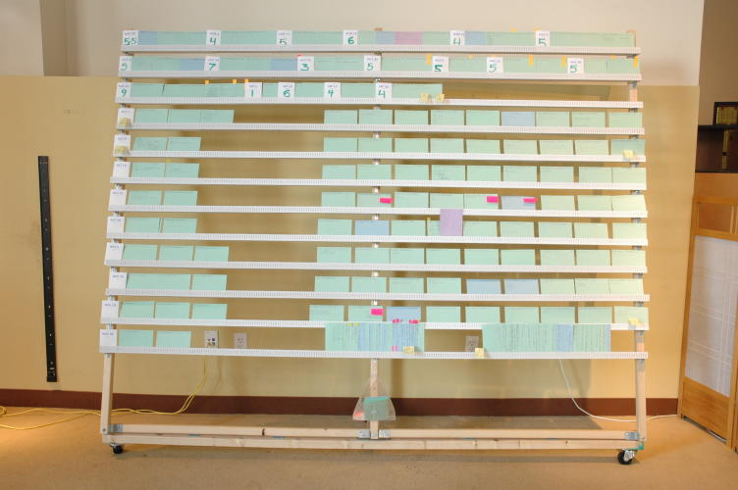

Slide 23
Types of Product Backlog Entries
Feature
  A feature is a distinguishing characteristic of a software item (for example, performance, portability, or functionality) [IEEE 829]
Epic
  An epic is a large feature awaiting break-down into smaller features; in a product backlog, it acts as a placeholder for these smaller features
(User) story
  A user story is a feature presented using a the user-story-pattern that is small enough to be implemented in a sprint
Refactoring
Bug report

Slide 24
Model of Product Backlog Items
Theme
Backlog Item
Feature
Epic
User Story
Bug Report
Refactoring

Slide 25
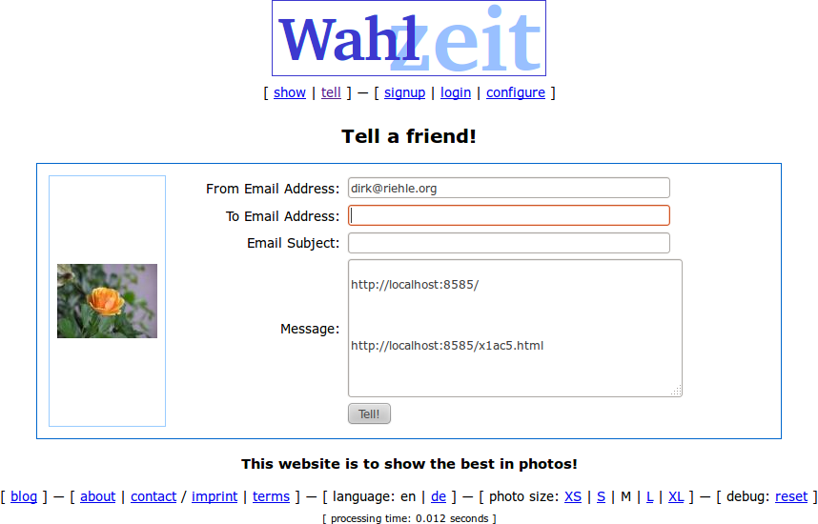
Flowers / Tell-a-Friend Implemented

Slide 26
Working with Product Backlog Items
Specifying
Prioritizing
Managing

Slide 27
Two Ways of Describing Features
Illustrations
  Properties
    Naturally incomplete
    Used to create discussion
  Notations
    Prose
    Simple User Story
    Regular User Story
    Structured Sentence
Specifications
  Properties
    Trying to be complete
    Used in contracting
  Notations
    Prose
    Use Case

Slide 28
Example Using Simple User Story
Tell a Friend
As a Flowers user, I need a function to tell a friend about a flower photo, so that I can share my passion for flowers and increase my network.
Properties
  Follows pattern
    As a user role
    I need a function
    So that I get business value
  Applicability
    Used to start discussions
    Unsuitable for contracts

Slide 29
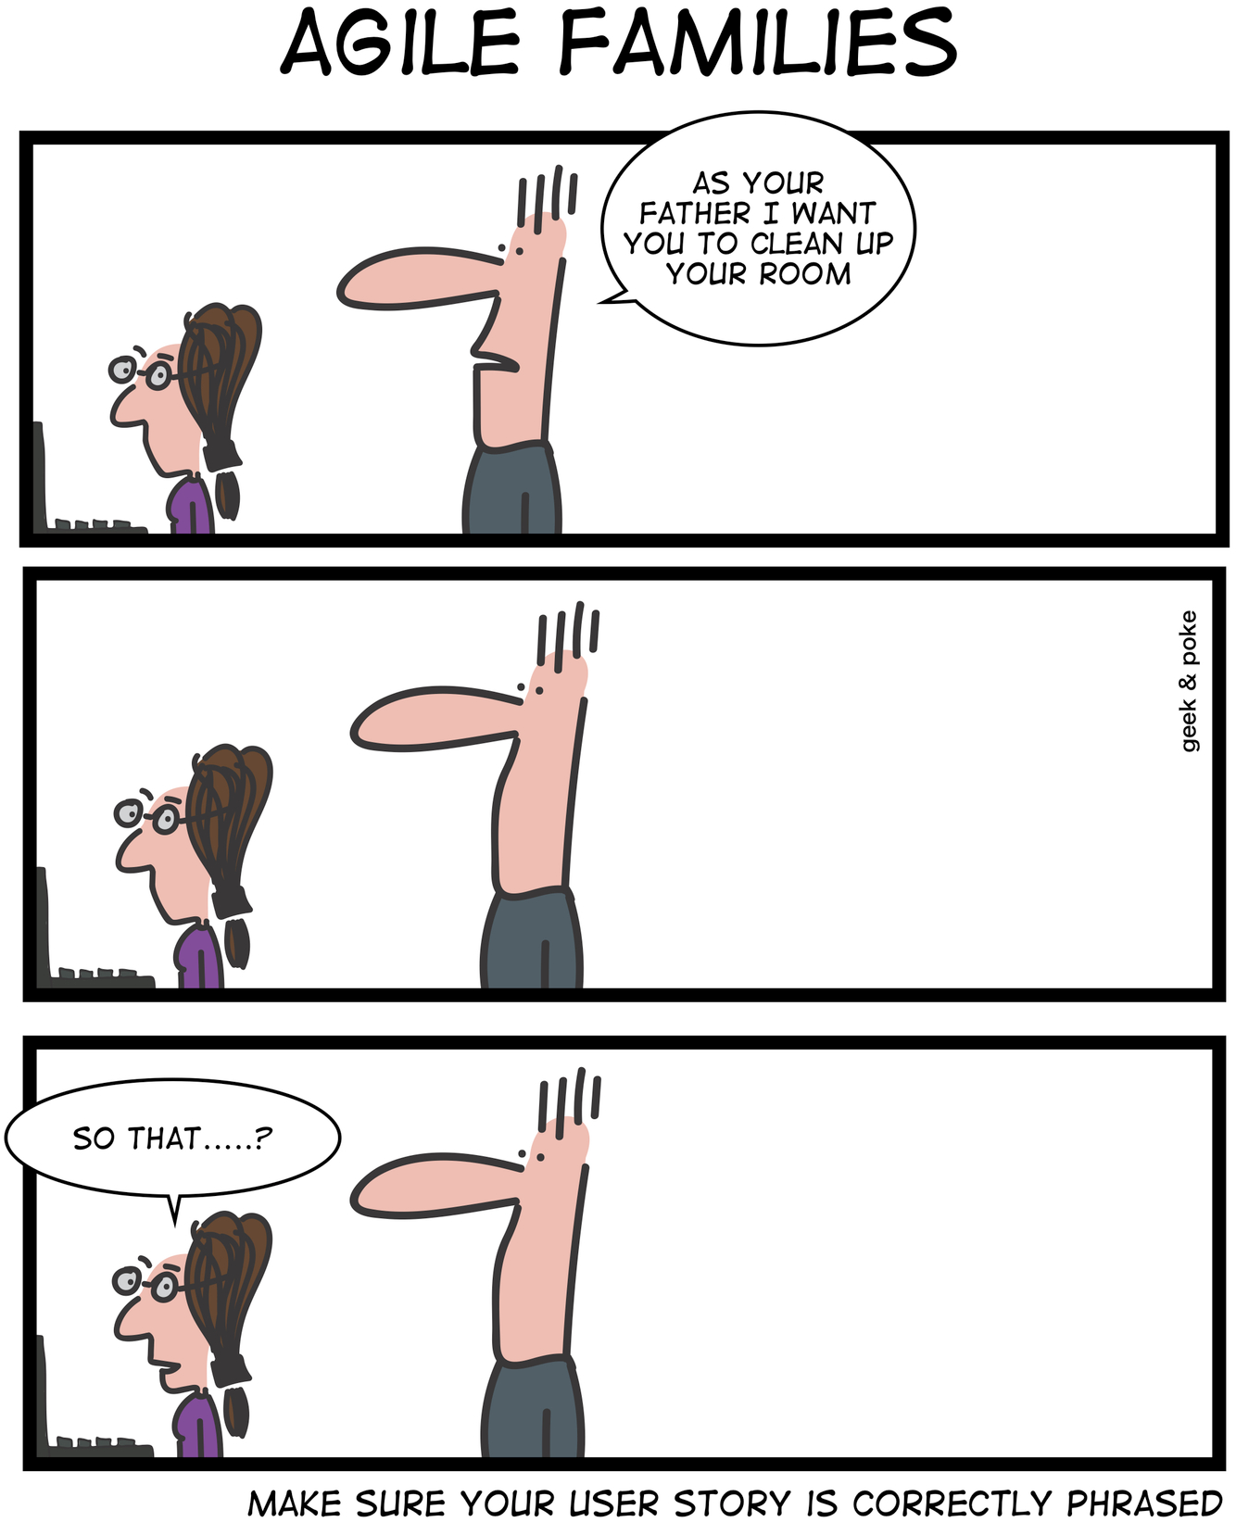

Slide 30
Example using Regular User Story
Tell a Friend
User Story
The user clicks on “Tell a Friend” and is shown a new dialog. The user enters their email address, the friend's email address, a subject and a message to that friend. Upon clicking OK, an email is sent to the friend.
Acceptance Criteria
A valid email is sent
  Proper from: and to: fields
  Proper content incl. valid links
Sender is cc:ed on email
Properties
  Tells a story
    Told from user perspective
    Is exemplary, not complete
  Provides acceptance criteria
    Should not add to specification
    Used in validating implementation
  Applicability
    Used to start discussions
    Unsuitable for contracts

Slide 31
Structured Sentence (Template)
“must”
“be able to”
<system>
“should”
“allow for”
<activity>
<object>
“could”
“...”

Slide 32
Example using Structured Sentence
Tell a Friend
Flowers must allow the user to send an email to a friend about the photo they were looking at.
Properties
  Describes a requirement
    Is declarative in nature
    Has defined semantics
  Open to interpretation
    No specification is complete
    May contain inconsistencies
  Applicability
    Suitable for contracts

Slide 33
Example using Prose
Tell a Friend
A user can click on TELL A FRIEND in the menu and below each photo. If s/he does so, he sees a new page with an email dialog. The fields are FROM, TO, SUBJECT, and BODY. The user can fill in only valid email addresses. The body is prefilled with the photo link. Upon OK, the email is sent, with the user cc:ed. Upon CANCEL, no email is sent. After this, the dialog returns to the main page with a status message EMAIL SENT above the main viewing area.
Properties
  Describes a model
    Tries to be complete
    Can be used in contracting
    Used in implementation validation
  Open to interpretation
    No specification is complete
    May contain inconsistencies
  Still dominant in industry!

Slide 34
Example using Use Case 1 / 2
Name: Tell a Friend
Description: Allows a user to tell a friend by email about Flowers
Actors: User, Visitor
Includes: None
Triggers: Menu Selection on Photo Page
Preconditions: Defined photo function is launched from
Invariants: None
Postconditions: On OK, email is sent; upon cancel, no email is sent
Default Scenario
1. User clicks on link
2. System provides dialog
3. User fills in fields
4. User clicks OK
5. System sends email
6. System returns to main page
Alternative Scenarios
1. User clicks on link
2. System provides dialog
3. User clicks cancel
4. System returns to main page

Slide 35
Example using Use Case 2 / 2
Flowers Service
Properties
  Describes a model
    Tries to be complete
    Can be used in contracting
  Applicability
    Used in implementation validation
    Used for specification guarantees
  Used in industry
    Part of UML, good tool support
Tell a
Friend
user
guest

Slide 36
Acceptance Criterion [DR]
An acceptance criterion for a backlog entry
  Is a proposition that must be true
    Before the entry can be accepted (signed-off on)

Slide 37
Acceptance Criteria [DR]
The (list of) acceptance criteria of a backlog entry
  Is a list of propositions
    That must all be true before the entry can be accepted

Slide 38
Story Points
Story point
  An arbitrary numeric measure of size of a given feature
Properties
  Is a measure of size, not of effort or duration
  Measured in non-linear increments, forcing choice
  Is socially agreed upon, depends on team estimation history
  Is independent of a particular person (and their skills)
  Is mapped to time using the team's velocity (dev. speed)
Points | Meaning
0 | No effort
1 | Minimal effort
2 | Small effort
3 | Medium effort
5 | Large effort
8 | Very large effort
13 | Too large effort

Slide 39
Size vs. Effort
Size
  Measured in arbitrary unit
  Are an estimate of complexity
  Are independent of time
  Does not depend on people
Effort
  Measured in person hours
  Are an estimate of “duration”
  Typically, this is “ideal time”
  Depends on implementer

Slide 40
Quality Criteria for Feature Descriptions
I | ndependent: Features should be independent of each other.
N | egotiable: A feature is man-made, not cast in stone.
V | aluable: Every feature should have business value.
E | stimatable: A feature should be precise so that size can be estimated.
S | mall: A feature should be small enough for one iteration.
T | estable: A feature should have testable success criteria.

Slide 41
Quiz: What’s Wrong with this Story? 1 / 3
User Registration
When trying to upload a profile photo, an unregistered user is first asked to register. After finishing registration, the user is automatically logged in. Then he or she can upload their profile picture. Upon successful completion of the upload, an email is sent to all friends.
Acceptance Criteria
User is registered
Photo is uploaded
Email is sent

Slide 42
Quiz: What’s Wrong with this Story? 2 / 3
Spam-free Reg. Email
Right after user registration, an email is sent to the unverified email address of the user with a unique link that verifies the user's account when he/she clicks on it (see Verify User by E-Mail). The email goes directly into the inbox of the user passing the spam filter.
Acceptance Criteria
All tags closed, no bad HTML code
No IP address in URL (plain text)
No user name in subject/email
No numbers in subject
No catchy words in subject
No capital letters in subject
Avoid utilizing phrases like “click here”
No BCC distribution
No dirty words
No images in email
Max. 2 colors in mail (no signal colors)
No big headings (max. size 14)
Check email against a Spam checker

Slide 43
Quiz: What’s Wrong with this Story? 3 / 3
Learn Java
As a software developer, I need to improve my Java skills, so that I can program faster and deliver more business value.
Acceptance Criteria
I can do more story points per iteration

Slide 44
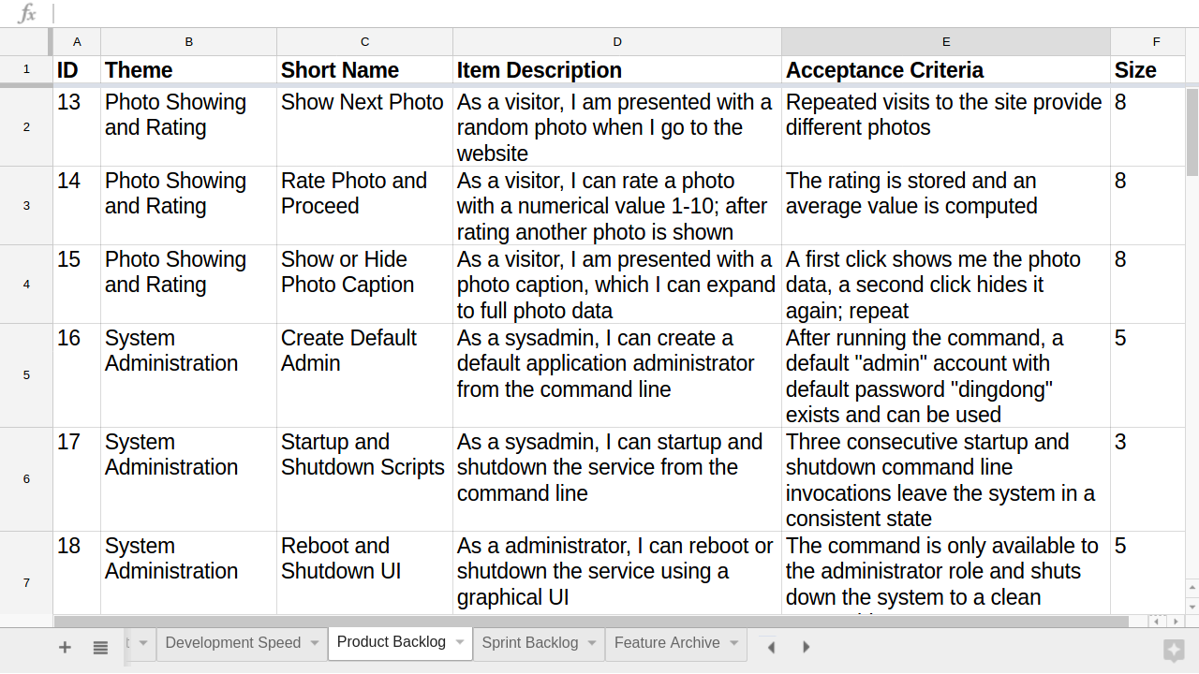
Item in Product Backlog (Artifact)

Slide 45
Prioritizing Features by Value and Risk
risk
high
realize
never
x
1
realize
first
value
value
low
3
realize
second
realize
last
2
high
risk
low

Slide 46
Classifying Features by Kano Model
customer satis-faction
high
exciters and
delighters
degree of feature
implementation
not at all
fully
must-have
linear
low

Slide 47
Feature Priority Categories
Essential / High
Conditional / Medium
Optional / Low

Slide 48
Quiz: How to Prioritize These Features?
1. Login
As a guest, I can login using my user account to get access to user functionality
2. Logout
As a logged-in user, I can logout to free up the computer for some other person
3. Lock-out User
As a user, my account is blocked, if I fail three times in a row when trying to log in
4. Tell a Friend
As a guest, I can tell my friends by email about a flower photo to share my passion

Slide 49
Relative Weighting (Practice) 1 / 2 [W99]
Definition
  A prioritization technique for
    Medium-priority features that are
    Independent of each other and of
    Roughly the same or similar effort
  Works up to a dozen features
Key inputs
  Customer: Relative benefit [1..9]
  Customer: Relative penalty [1..9]
  Developer: Relative cost [1..9]
  Developer: Overall risk [1..9]

Slide 50
Relative Weighting (Practice) 2 / 2
(
+
)
P =
Relative
Benefit
Relative
Penalty
as %
(
+
)
Relative
Cost
Overall
Risk
as %
P = prioritization key figure (rational number)

Slide 51
Feature | Relative Benefit | Relative Penalty | Total Value | Value % | Relative Cost | Cost % | Relative Risk | Risk % | Priority
1. Query status of a vendor order | 5 | 3 | 13 | 8.4 | 2 | 4.8 | 1 | 3.0 | 1.345
2. Generate a Chemical Stockroom inventory report | 9 | 7 | 25 | 16.2 | 5 | 11.9 | 3 | 9.1 | .987
3. See history of a specific chemical container | 5 | 5 | 15 | 9.7 | 3 | 7.1 | 2 | 6.1 | .957
4. Print a chemical safety datasheet | 2 | 1 | 5 | 3.2 | 1 | 2.4 | 1 | 3.0 | .833
5. Maintain a list of hazardous chemicals | 4 | 9 | 17 | 11.0 | 4 | 9.5 | 4 | 12.1 | .708
6. Modify a pending chemical request | 4 | 3 | 11 | 7.1 | 3 | 7.1 | 2 | 6.1 | .702
7. Generate an individual laboratory inventory report | 6 | 2 | 14 | 9.1 | 4 | 9.5 | 3 | 9.1 | .646
8. Search vendor catalogs for a specific chemical | 9 | 8 | 26 | 16.9 | 7 | 16.7 | 8 | 24.2 | .586
9. Check training database for hazardous chemical training record | 3 | 4 | 10 | 6.5 | 4 | 9.5 | 2 | 6.1 | .517
10. Import chemical structures from structure drawing tools | 7 | 4 | 18 | 11.7 | 9 | 21.4 | 7 | 21.2 | .365
Totals | 54 | 46 | 154 | 100 | 42 | 100 | 33 | 100 | --

Slide 52
Feature Archive
The feature archive contains all the functionality provided by the current state of the product. [DR]

Slide 53
Feature Archive [DR]
Feature archive
  Contains all functionality
    Provided by the current state of the product

Slide 54
Review / Summary of Session
Scrum product management
  Definition, role, and practices
  Product management artifacts
    Product vision (vs. project mission)
    Glossary (vs. domain model)
    Product backlog
    Feature archive
Product features
  Description mechanisms (vs. specification)
  Prioritization methods

Slide 55
Thank you! Questions?
dirk.riehle@fau.de – http://osr.cs.fau.de
dirk@riehle.org – http://dirkriehle.com – @dirkriehle
DR

Slide 56
Credits and License
Original version
  © 2012-2019 Dirk Riehle, some rights reserved
  Licensed under Creative Commons Attribution 4.0 International License
Contributions
  ...

